Slide 1

CREDIT CARD MARKETING classification challenge
Robert Meier
Felix Ley
Carolin Vogt

Slide 2




ROADMAP What can be expected today?
1
2
3
4
BUSINESS PROBLEM
RAW DATA INSIGHTS
MODEL IMPROVEMENT
ACHIEVEMENTS & ACTIONS
… definition of target for credit card marketing campaign
... introduction to our mission & main focus
… description of remarkable customer data
… challenges for solving the classification problem
… description of taken assumptions
… implementation of all actions pursue to increase model accuracy and recall
… presentation of our solutions approach
… presentation of achievements based on solution approach
.. actions for further improvements of credit card marketing model

Slide 3
BUSINESS PROBLEM What is the methodical background of a classification problem?
TARGET
Increasing the offer acceptance rate for credit cards within our marketing campaign. In the future, not every customer will receive offers.
MISSION
Generating remarkable insights from customer data
Creating an optimized machine learning classification model for future predicting customer acceptance based on unique features
FOCUS
Reducing the number of false negative predicted customer.
NO
TRUE
NEGATIVE
FALSE
POSITIVE
TRUE LABEL
YES
FALSE
NEGATIVE
TRUE
POSITIVE
NO
YES
PREDICTIONS
Notes:
A bank is sending out Marketing mails to their customers to win them for a new Credit Card
The goal is to find the minimum number of letters to send without possibly missing a customer who would accept an offer.

Slide 4
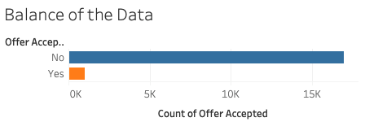
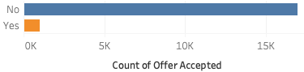
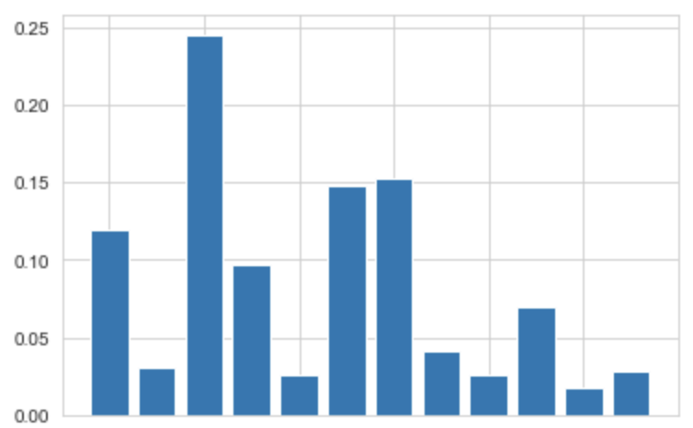
Balance of the data
RAW DATA INSIGHTS Things you like to know
Key factors
NUMBER OF CUSTOMER
18.000 historic entries
The data shows financial, family and promotional information about each customer
Rate of features impact
Challenges
RATE OF FEATURE IMPORTANCE
Avoiding direct correlation between features
Data is unbalanced – bad for classification
Focusing on features with high impact on offer acceptance rate
Customer insights
The customer with following attributes is most likely to accept an credit card offer:
Medium average balance
Low credit rating and income level
Offer addressed by postcards
No. of credit cards
Average balance
Income level
Credit Rating
Household size
Mailer type
FEATURES OF CLASSIFICATION MODEL

Slide 5
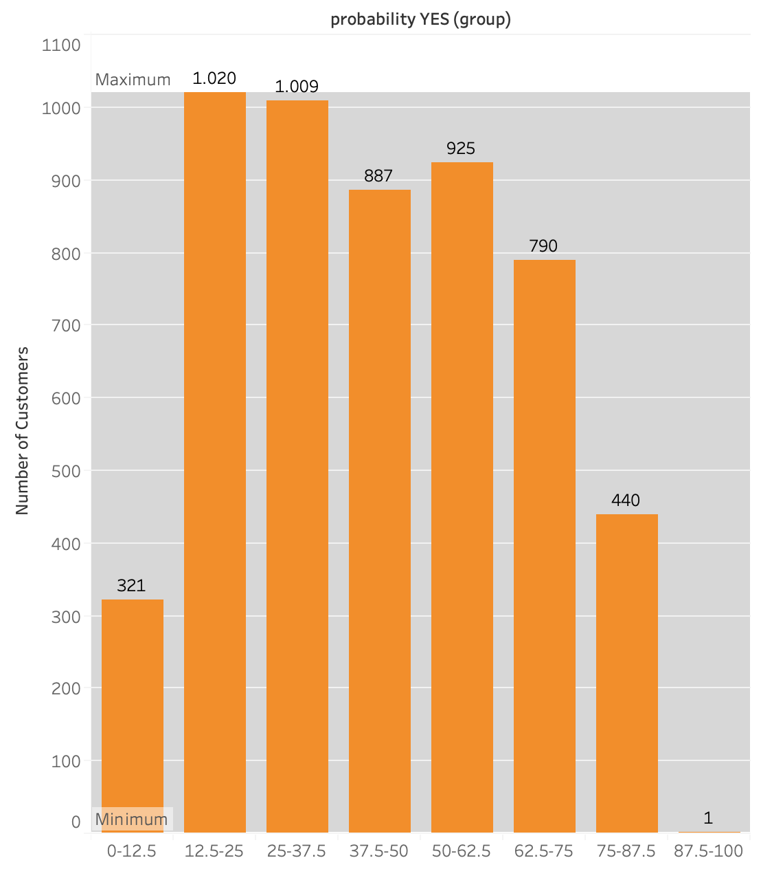

MODEL IMPROVEMENT Predicted classification is based on the probability distribution for our target feature
THRESHOLD
50%
About 1,900 customers are predicted with low or medium-low certainty to reject the offer
Probability for a positive offer acceptance is for many customers near the threshold of 50%
NUMBER OF CUSTOMER
APPROACH
Adjust the threshold value according to the created classification machine learning model, adapted to the existing customer data and the target to minimize false negatives
PROBABILITY FOR ACCEPTING THE OFFER

Slide 6
MODEL IMPROVEMENT Adjusting the threshold is always a trade-off!
FALSE POSITIVE/ FALSE NEGATIVE RATE
(for classification model with logistic regression)
THRES-HOLD | FALSE NEGATIVE | FALSE POSITIVE | TRUE NEGATIVE
starting point (50%) | 244 | 6,425 | 10,574
1st plateau (38%) | 134 (- 110) | 9,189 (+ 2,764) | 7,810 (- 2,764)
2nd plateau (27%) | 37 (- 97) | 12,296 (+ 3,707) | 4,703 (- 3,107)
absolut 0 (13%) | 0 (- 37) | 15,924 (+ 3,628) | 1,075 (- 3,628)
THRESHOLD
50%
THRESHOLD
38%
FALSE POSITIVE RATE
FALSE NEGATIVE RATE
THRESHOLD
27%
THRESHOLD
13%
THRESHOLD
Notes:
The identification for the thresholds/ the absolut 0 for false negative is automized
Table applied on our dataset for 18,000 rows

Slide 7





ACHIEVEMENTS & ACTIONS
Clues for improving the marketing campaign for credit cards
ACHIEVEMENTS
ACTIONS
Identification of customer features relevant to accept a credit card offer
Development of a machine learning classification model
(1)
Identification of customer most likely to reject the offer
Reducing Marketing effort by 6%
(2)
Tool to adjust the threshold
Trade-off between marketing costs and offer acceptance rate
Uncertain forecast due to high imbalanced data
Changing the mailer type to postcard exclusively.
Further feature engineering could reduce false positive rate
Notes:
Quick wins:
Increased efficiency by reducing marketing costs by 6%
Sending out less mails (Using postcard (-20% costs)

Slide 8
Thanks for your attention!

Slide 9
Backup

Slide 10
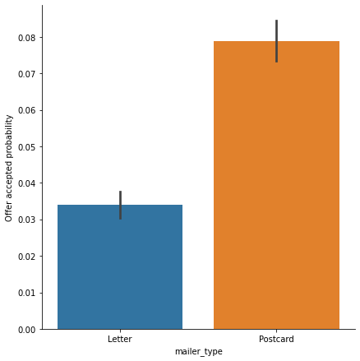
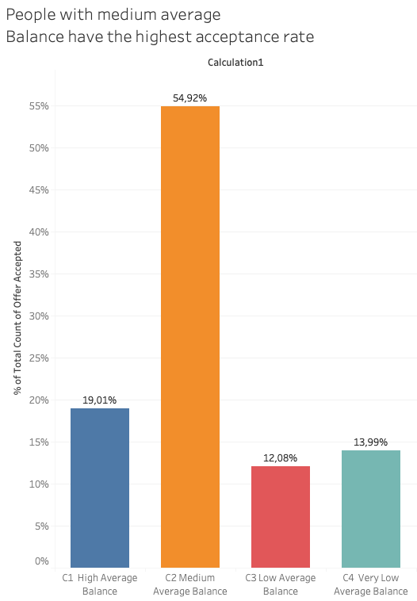
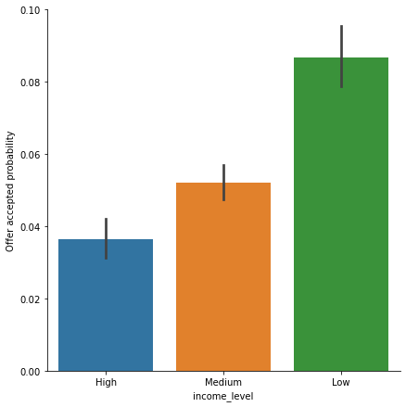
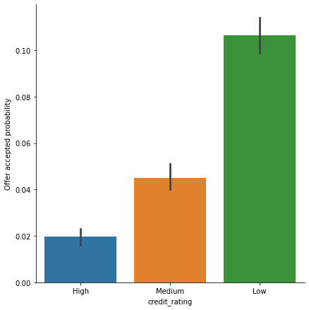
Backup
Average balance
Low creditrating and income level
Adressed by postcards

Slide 11
MODEL IMPROVEMENT Adjusting the threshold is always a trade-off!
TEST SET
FALSE POSITIVE/ FALSE NEGATIVE RATE
(for classification model with logistic regression)
THRES-HOLD | FALSE NEGATIVE | FALSE POSITIVE | TRUE NEGATIVE
starting point (50%) | 74 | 1916 | 3177
1st plateau (38%) | 40 (- 34) | 2753 (+ 837) | 2340 (- 837)
2nd plateau (27%) | 11 (- 29) | 3684 (+ 931) | 1409 (- 931)
absolut 0 (13%) | 0 (- 11) | 4771 (+ 1087) | 322 (- 1087)
THRESHOLD
50%
THRESHOLD
38%
FALSE POSITIVE RATE
FALSE NEGATIVE RATE
THRESHOLD
27%
THRESHOLD
13%
THRESHOLD
Notes:
The identification for the thresholds/ the absolut 0 for false negative is automized

Slide 12
 | 50% |  | 18000 | 38% |  | 18000 | 27% |  | 18000 | 13% |  | 18000
TN | 3168 | 0,58742815 | 10574 | 2340 | 0,43389579 | 7810 | 1409 | 0,2612646 | 4703 | 322 | 0,05970703 | 1075
FP | 1925 | 0,35694419 | 6425 | 2753 | 0,51047654 | 9189 | 3684 | 0,68310773 | 12296 | 4771 | 0,88466531 | 15924
FN | 73 | 0,01353607 | 244 | 40 | 0,00741702 | 134 | 11 | 0,00203968 | 37 | 0 | 0 | 0
TP | 227 | 0,0420916 | 758 | 260 | 0,04821064 | 868 | 289 | 0,05358798 | 965 | 300 | 0,05562767 | 1001

Slide 13
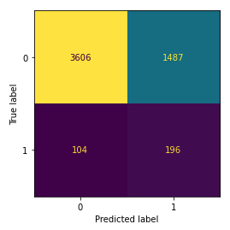
Modell 1 Bussiness case improvement
no response
offer_accepted
50%
Insert confusion matrix , kappa and calculation

